Slide 1
CS 6476 Project 1
[Ruize Cao]
[rcao73@gatech.edu]
[rcao73]
[904012084]

Slide 2
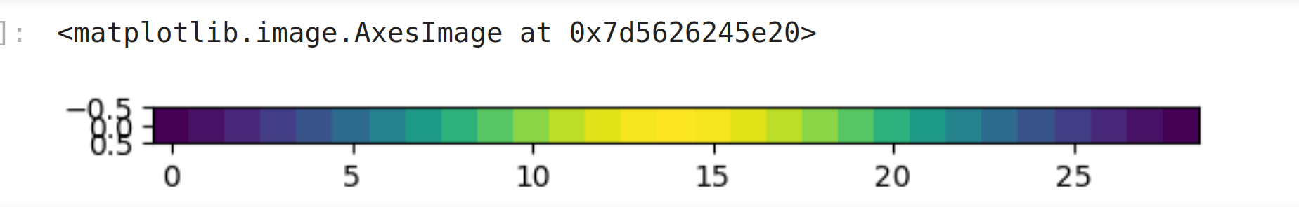
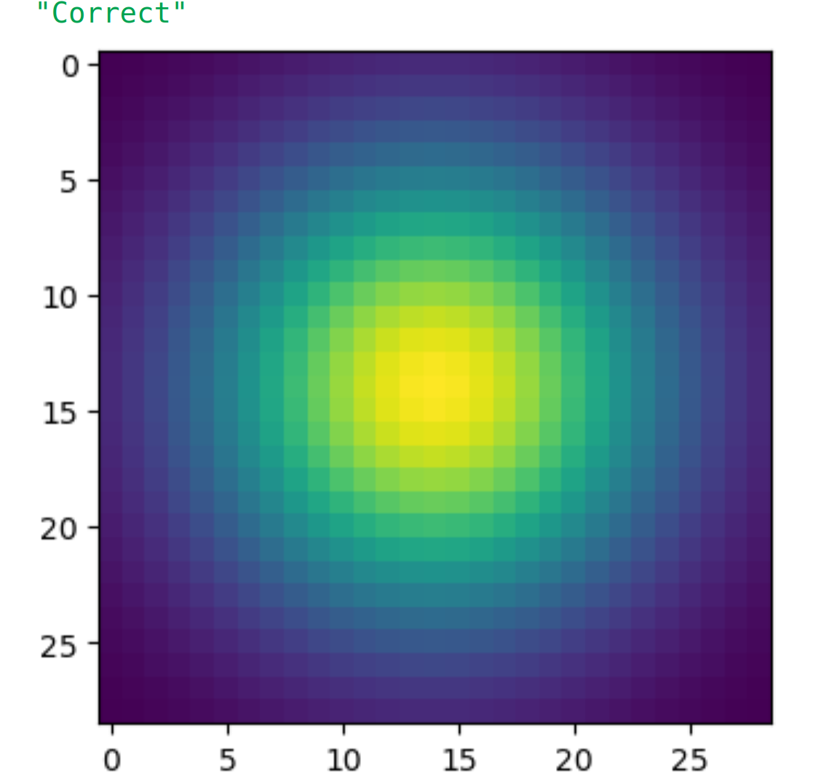
Part 1: Image filtering
[Describe your implementation of my_conv2d_numpy() in words. Make sure to discuss padding, and the operations used between the filter and image.] [0.5 pt]
I firstly load the image data in the range [0,1]. Then I calculate the number of padded pixels to each axis according to the the size of kernel. And padded the original image array according to the results. Then I flipped the filter array upside down and left to right. Then I element-wise product filter and corresponding region in image in a three-levels nested for-loop. From outer layer to inner layer are channel, row, and column. Finally, replace center pixel with the sum of product result, one by one, to gain the filtered image.
[insert visualization of Gaussian kernel from project-1.ipynb here] [0.25 pt each]
1D:
2D:

Slide 3
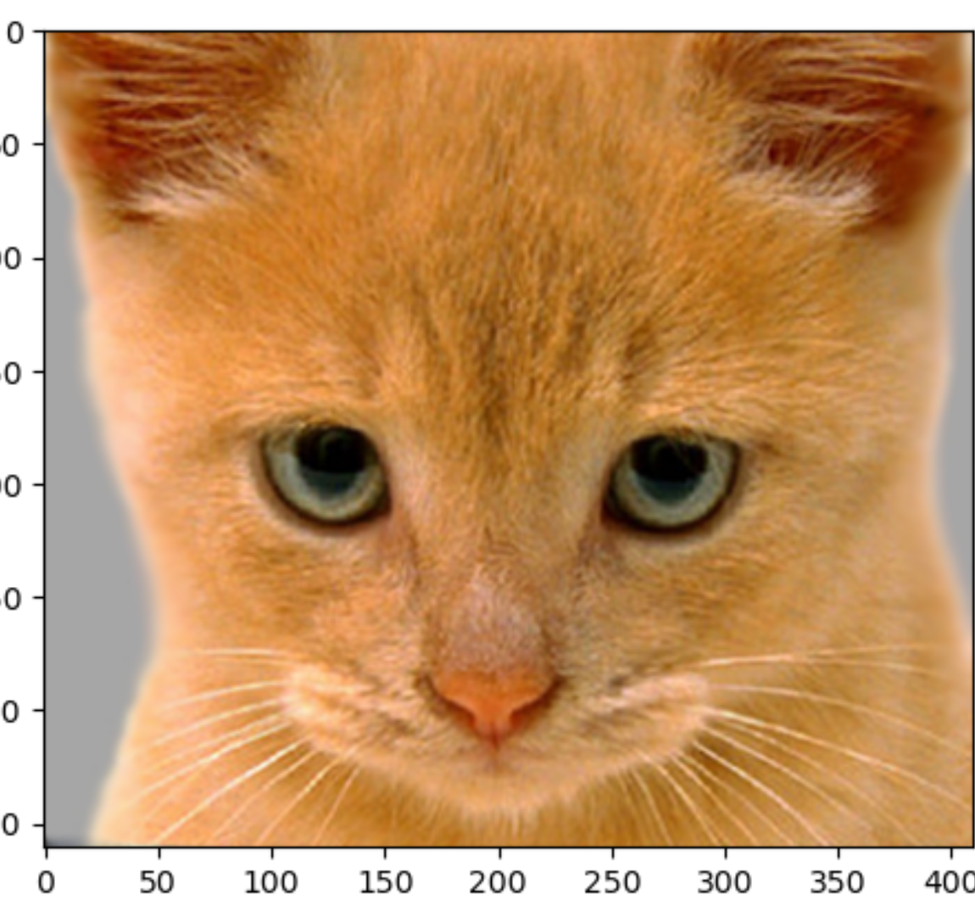
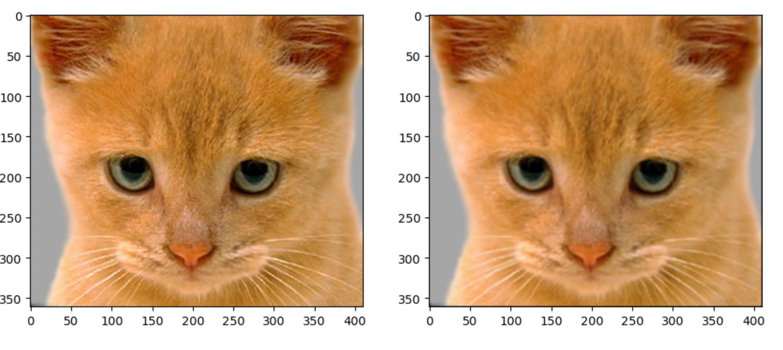
Part 1: Image filtering
Identity filter
[insert the results from project-1.ipynb using 1b_cat.bmp with the identity filter here] [0.5 pt]
Small blur with a box filter
[insert the results from project-1.ipynb using 1b_cat.bmp with the box filter here] [0.5 pt]

Slide 4
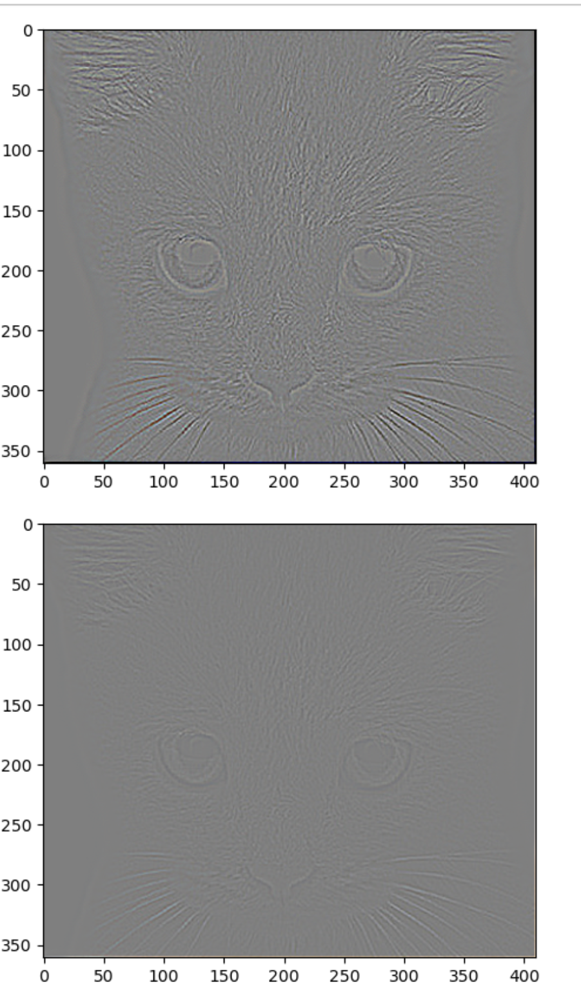
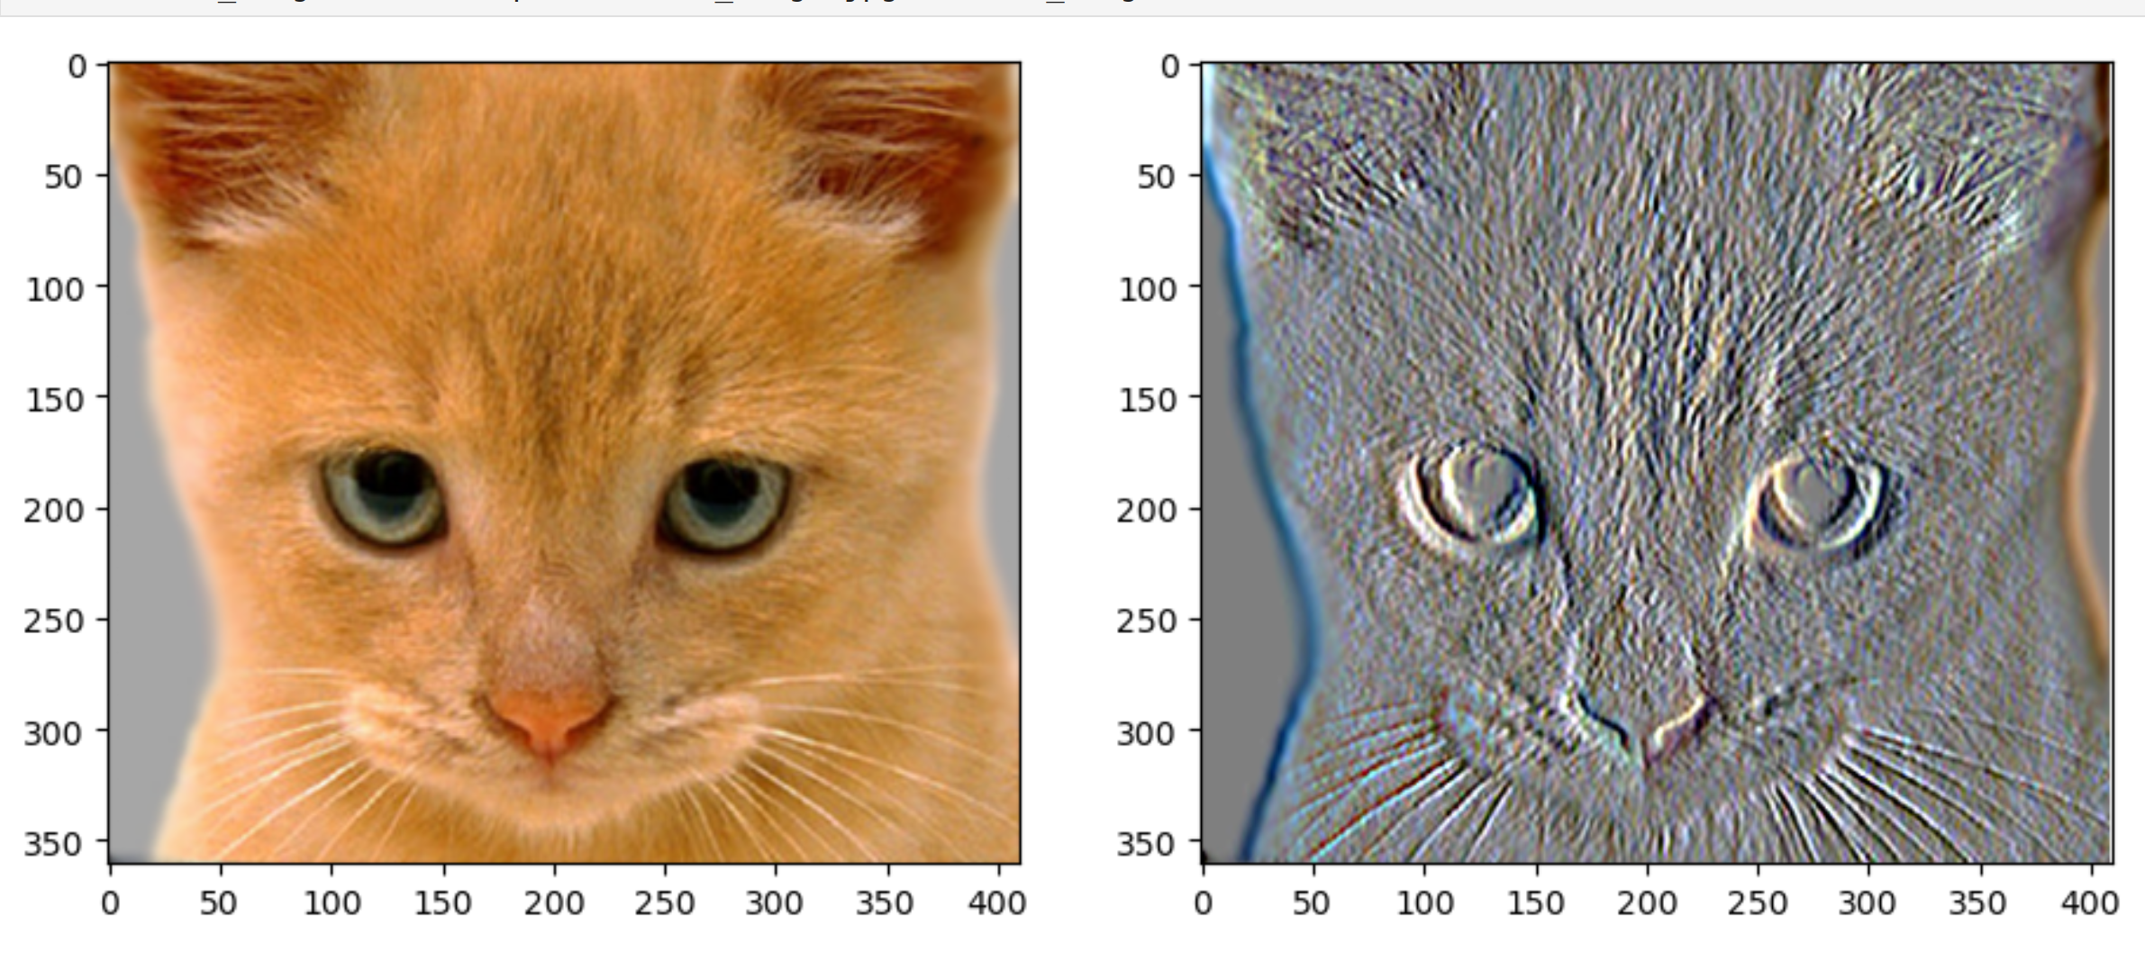
Part 1: Image filtering
Discrete Laplacian filter
[insert the results from project-1.ipynb using 1b_cat.bmp with the discrete Laplacian filter here] [0.75 pt]
Sobel filter
[insert the results from project-1.ipynb using 1b_cat.bmp with the Sobel filter here] [0.75 pt]

Slide 5
Part 1: Hybrid images
[Describe the three main steps of create_hybrid_image() here. Explain how to ensure the output values are within the appropriate range for matplotlib visualizations.] [0.375 pt]
Cat + Dog
[insert your hybrid image here] [0.5 pt]
Cutoff frequency: [insert the value you used for this image pair] [0.125 pt]

Slide 6
Part 1: Hybrid images
Motorcycle + Bicycle
[insert your hybrid image here] [0.5 pt]
Cutoff frequency: [insert the value you used for this image pair] [0.125 pt]
Plane + Bird
[insert your hybrid image here] [0.5 pt]
Cutoff frequency: [insert the value you used for this image pair] [0.125 pt]

Slide 7
Part 1: Hybrid images
Einstein + Marilyn
[insert your hybrid image here] [0.5 pt]
Cutoff frequency: [insert the value you used for this image pair] [0.125 pt]
Submarine + Fish
[insert your hybrid image here] [0.5 pt]
Cutoff frequency: [insert the value you used for this image pair] [0.125 pt]

Slide 8
Part 2: Hybrid images with PyTorch
Cat + Dog
[insert your hybrid image here] [0.5 pt]
Motorcycle + Bicycle
[insert your hybrid image here] [0.5 pt]

Slide 9
Part 2: Hybrid images with PyTorch
Plane + Bird
[insert your hybrid image here] [0.5 pt]
Einstein + Marilyn
[insert your hybrid image here] [0.5 pt]

Slide 10
Part 2: Hybrid images with PyTorch
Submarine + Fish
[insert your hybrid image here] [0.5 pt]
Part 1 vs. Part 2
[Compare the run-times of Parts 1 and 2 here, as calculated in project-1.ipynb. Which method is faster?] [0.5 pt]

Slide 11
Part 3: Understanding input/output shapes in PyTorch
[Consider a 1-channel 7x7 image and a 3x3 filter. What are the output dimensions of a convolution with the following parameters? [1 pt]
Stride = 1, padding = 0, dilation = 0?
Stride = 2, padding = 0, dilation = 0?
Stride = 1, padding = 1, dilation = 0?
Stride = 2, padding = 1, dilation = 0?
Stride = 1, padding = 0, dilation = 1?
Stride = 2, padding = 0, dilation = 1?
Stride = 1, padding = 1, dilation = 1?
Stride = 2, padding = 1, dilation = 1?
]
[What are the input & output dimensions of the convolutions of the dog image and a 3x3 filter with the following parameters: [1 pt]
Stride = 1, padding = 0, dilation = 0
Stride = 2, padding = 0, dilation = 0
Stride = 1, padding = 1, dilation = 0
Stride = 2, padding = 1, dilation = 0
Stride = 1, padding = 0, dilation = 1
Stride = 2, padding = 0, dilation = 1
Stride = 1, padding = 1, dilation = 1
Stride = 2, padding = 1, dilation = 1
?]

Slide 12
Part 3: Understanding input/output shapes in PyTorch
[How many filters did we apply to the dog image?] [0.25 pt]
[Section 3 of the handout gives equations to calculate output dimensions given filter size, stride, and padding. What is the intuition behind this equation?] [0.75 pt]

Slide 13
Part 3: Understanding input/output shapes in PyTorch
[insert visualization 0 here] [0.5 pt]
[insert visualization 1 here] [0.5 pt]

Slide 14
Part 3: Understanding input/output shapes in PyTorch
[insert visualization 2 here][0.5 pt]
[insert visualization 3 here][0.5 pt]

Slide 15
Part 4: Frequency Domain Convolutions
[Insert the visualizations of the dog image in the spatial and frequency domain] [1 pt with 0.5 pt each]
[Insert the visualizations of the blurred dog image in the spatial and frequency domain] [1 pt with 0.5 pt each]

Slide 16
Part 4: Frequency Domain Convolutions
[Insert the visualizations of the 2D Gaussian in the spatial and frequency domain] [0.5 with 0.25 pt each]
[Why does our frequency domain representation of a Gaussian not look like a Gaussian itself? How could we adjust the kernel to make these look more similar?] [0.5 pt]

Slide 17
Part 4: Frequency Domain Convolutions
Insert the final sharpened image of bird
[0.5 pt]
Explain how increasing/decreasing the Laplacian kernel size affect the sharpening operation.
Also, explain how values in Laplacian kernel (central and neighbouring coefficient) affect sharpening [0.5 pt]

Slide 18
Conclusion
[How does varying the cutoff frequency value or swapping images within a pair influences the resulting hybrid image?] [1 pt]

